Slide 1
Implementation, Development and Testing of a Robotic 3D Printing System
Louis Huygens

Slide 2
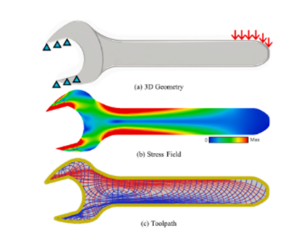
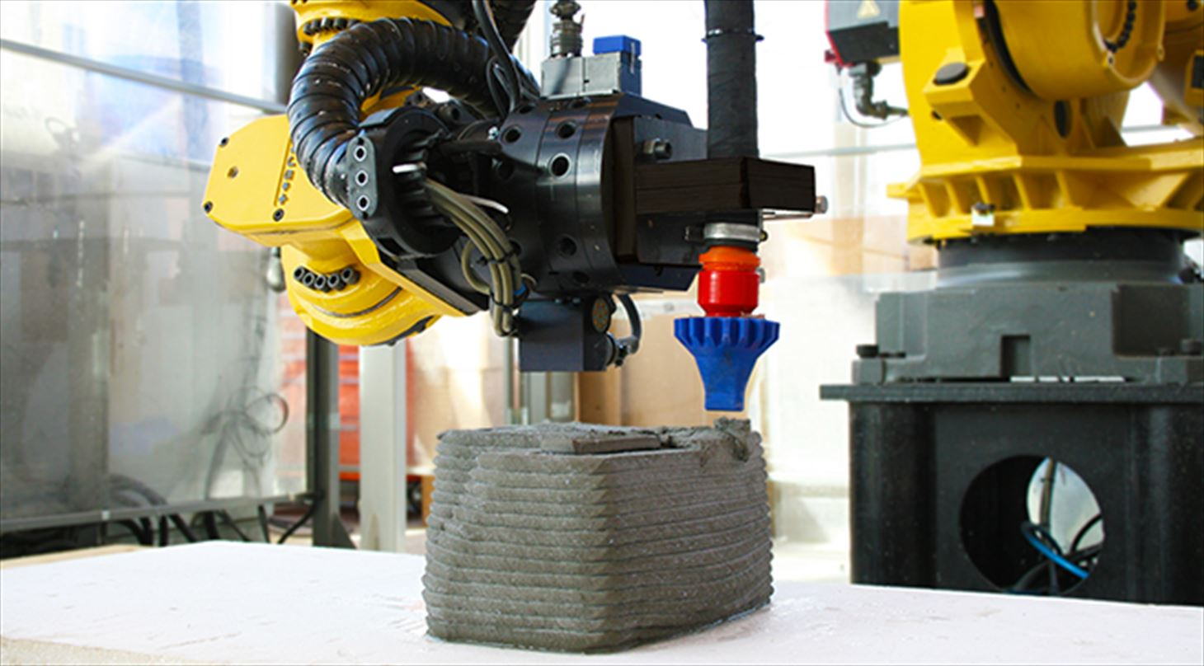
Introduction and Context What is robotic 3D printing? Why are we interested?
What is it?
Use of a 6DoF robotic arm to perform 3D printing – as opposed to standard cartesian printers
Print head orientation can be fully controlled – direction of printing can be altered
Benefits
Layer lines oriented for loading requirements
Printing on non-planar surfaces
Minimised use of support material
Larger print volume
Applications
Advanced composite design
Replication of natural structures
Large scale construction
Mass manufacture
E. Sales, T.-H. Kwok and Y. Chen, “Function-aware slicing using principal stress line for toolpath planning in additive manufacturing,” Journal of Manufacturing Processes , vol. 64, pp. 1420-1433, 2021.
T. J. Andersen, “3D printed buildings,” Danish Technological Institute, December 2018. [Online]. Available: https://www.dti.dk/projects/3d-printed-buildings/36993. [Accessed 10 May 2024].

Slide 3
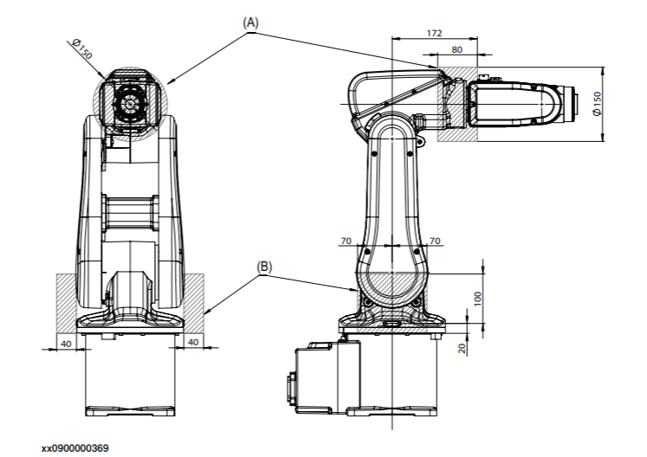
Project Brief What is expected?
Scope
Produce a fully capable robotic 3D printing system
System to use ABB IRB120 robotic arm with IRC5 controller
Hemera print head, temperature controller, microprocessor and stepper driver provided
Do not need to demonstrate printing in different orientations – functionality should be there for further development
Use typical off the shelf components – cheap, replaceable and documented
Resources
12-week timeline
2 students allocated to project – myself and Ian
Additional support from first and second years
Combined £500 budget
ABB, “Product specification IRB120,” 29 May 2019. [Online]. Available: https://library.e.abb.com/public/6aed5e91083f4fceb358eea2fe4c1bab/3HAC035960%20PS%20IRB%20120-en.pdf?x-sign=edIex5StIjpgmJBJJ95tak9NHdyuuut6mzzJHESGKt5i1JG8dhLRBdvggKptgBJn. [Accessed 25 March 2024].

Slide 4
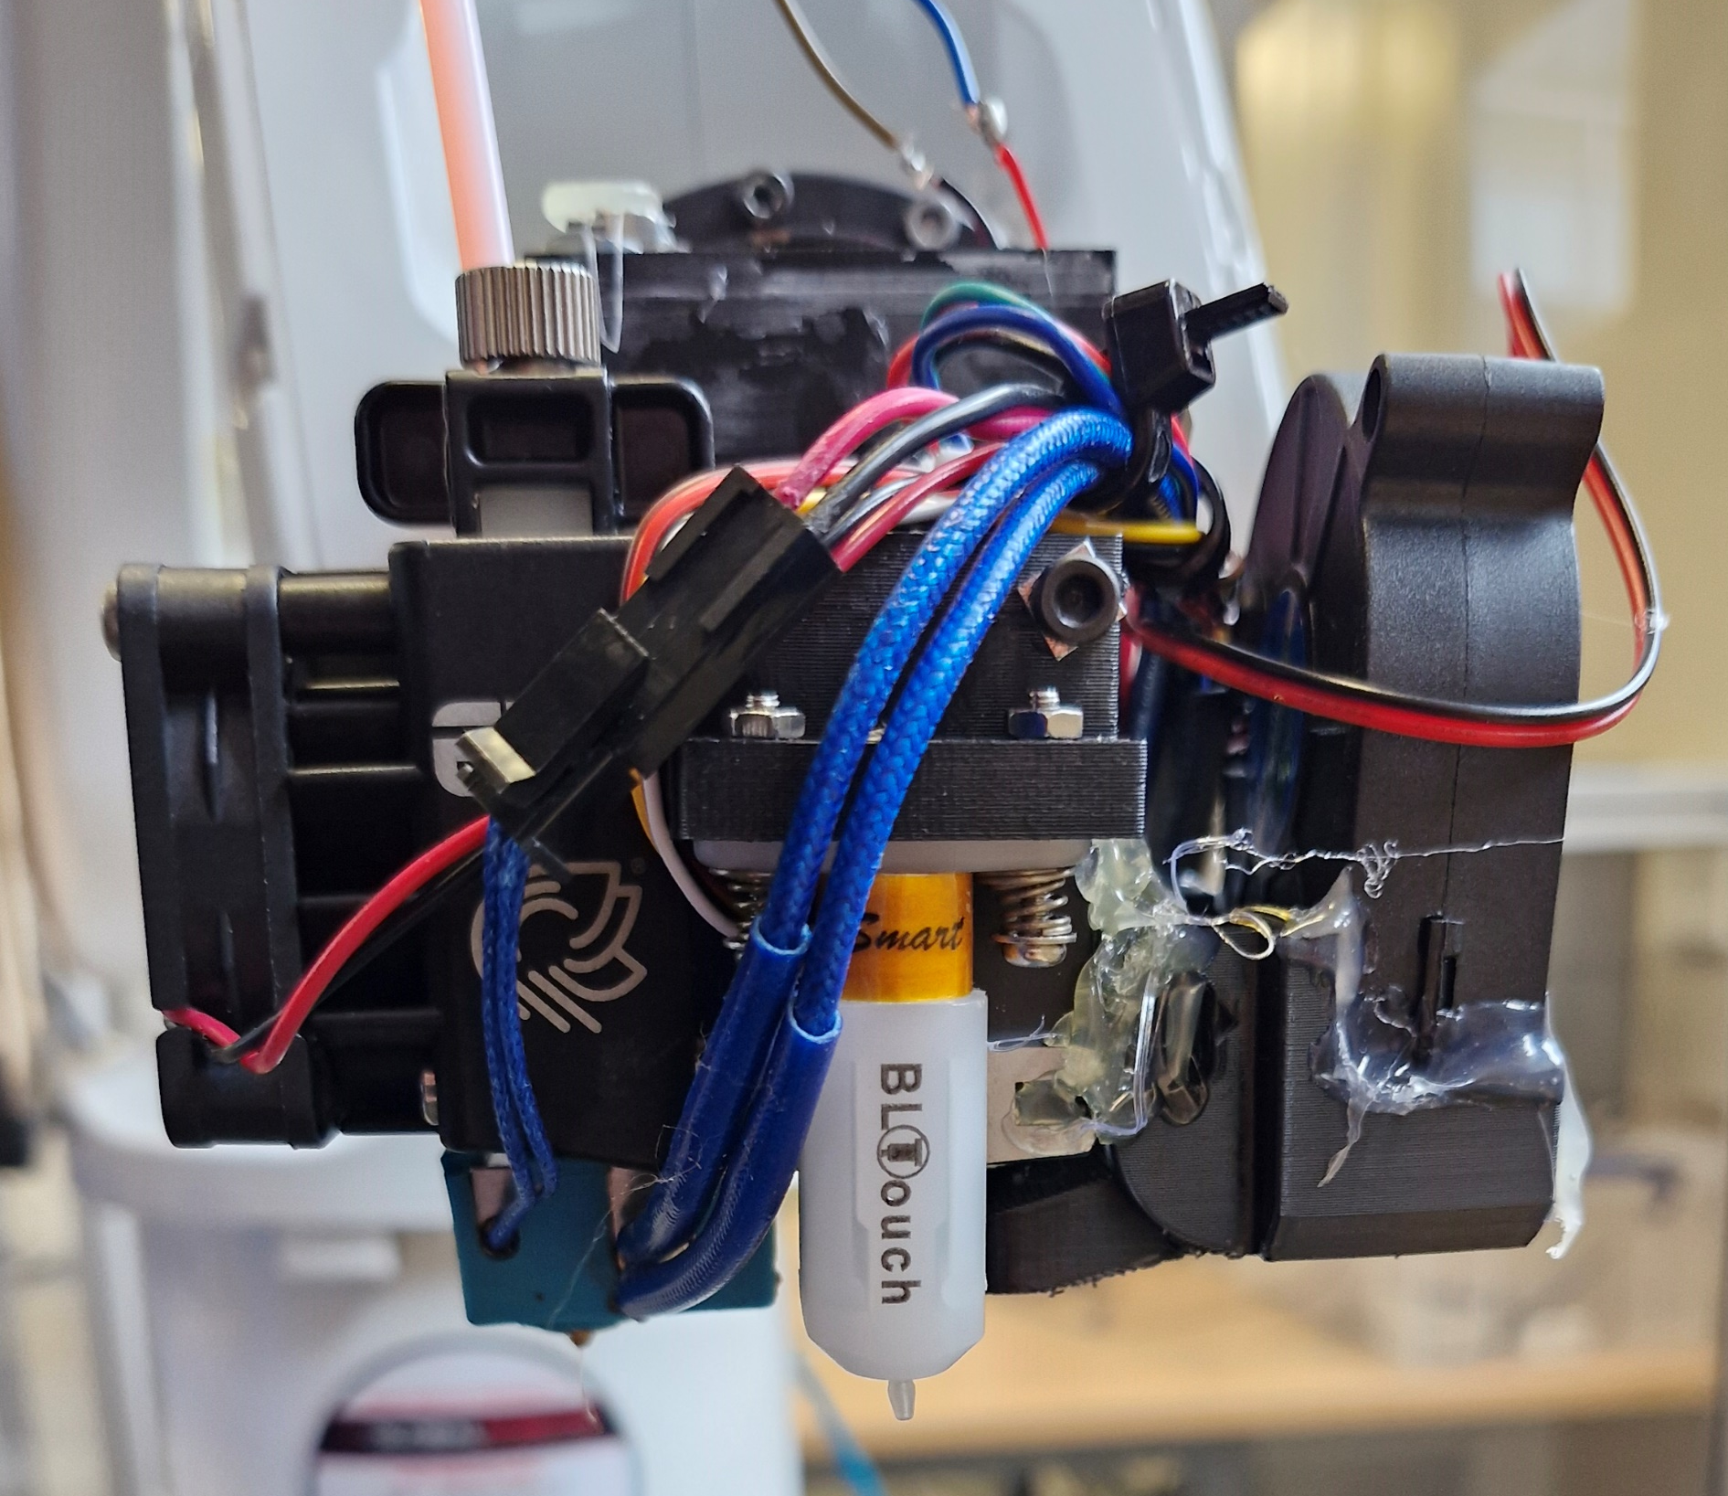
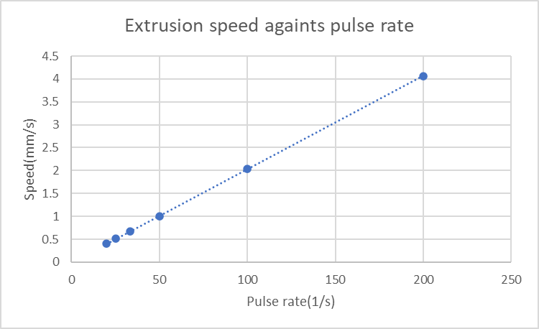
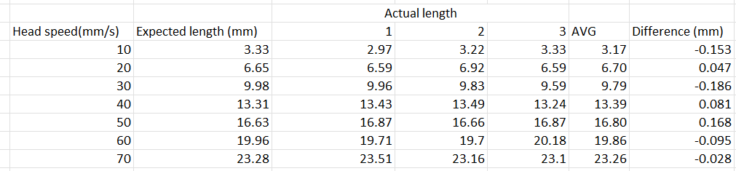
Print Head Speed Control
Speed Control
Extrusion driven by a stepper motor, controlled by stepper driver
Input pulses/s directly relate to extrusion speed
Relationship derived; Arduino used to generate pulses
Testing conducted, ±0.1mm between desired and achieved extrusion length
Communication between Arduino and robot controller to synchronise movement speed

Slide 5
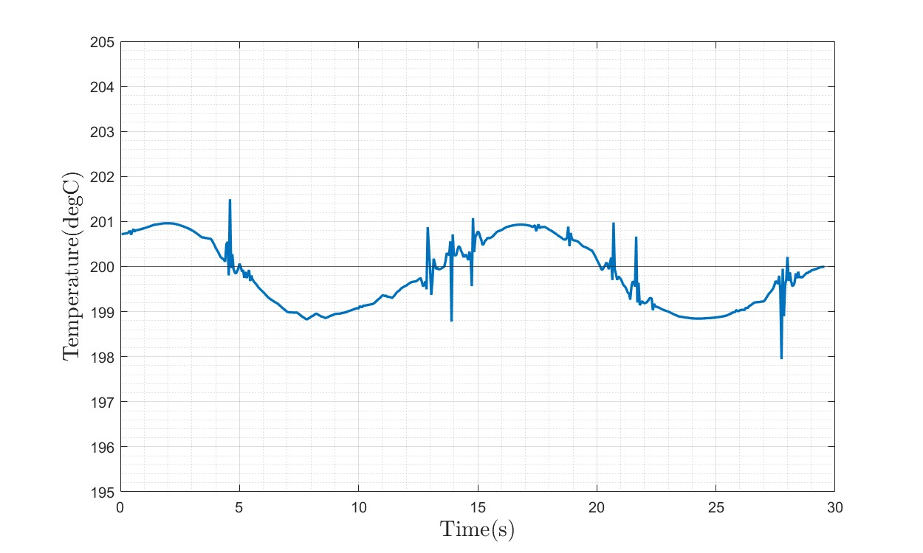
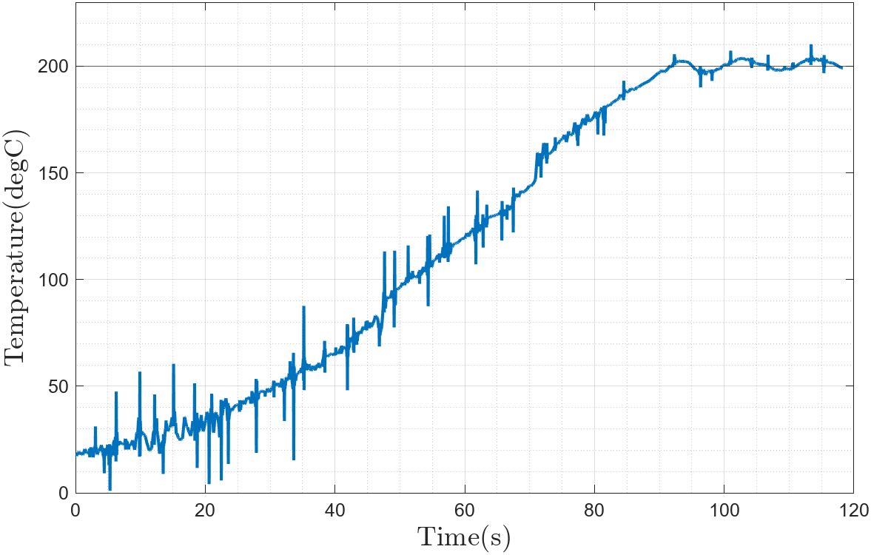
Print Head Temperature Control
Temperature Control
Hot end controlled with Bang-Bang control unit
Viability tested
Measured using potential divider circuit
Logged using Arduino
Achieves temperature variance of ±1°C
Oscillation at steady state, suitable for basic PLA printing
No ability to set target temperature
Plots show steady state and cold start temperature profiles

Slide 6
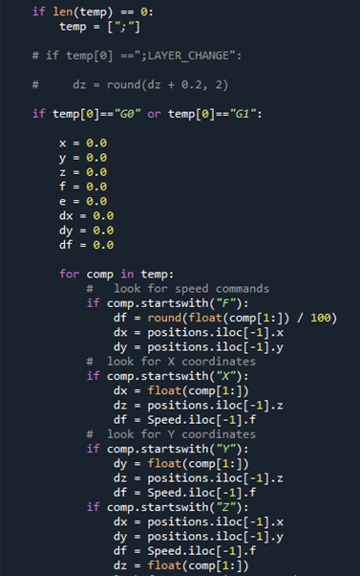
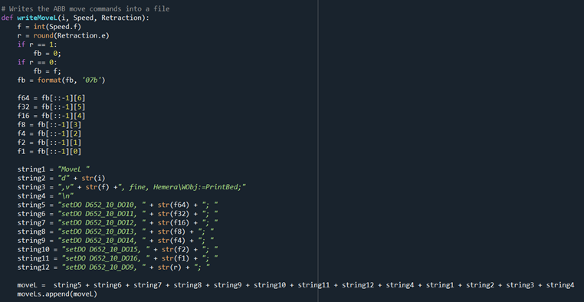
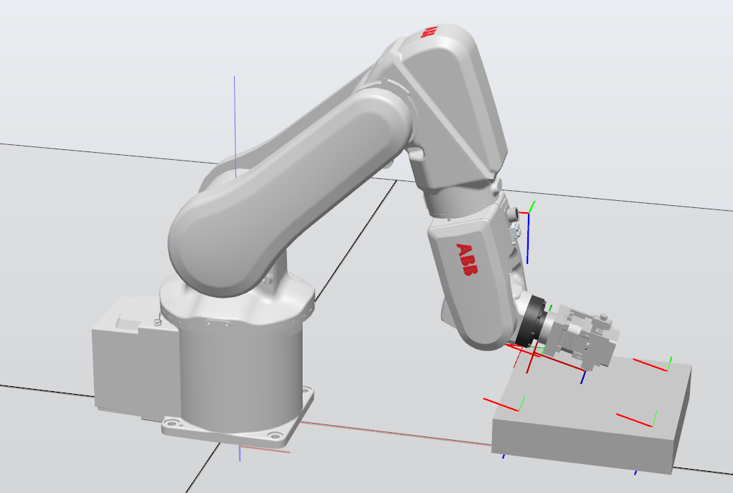
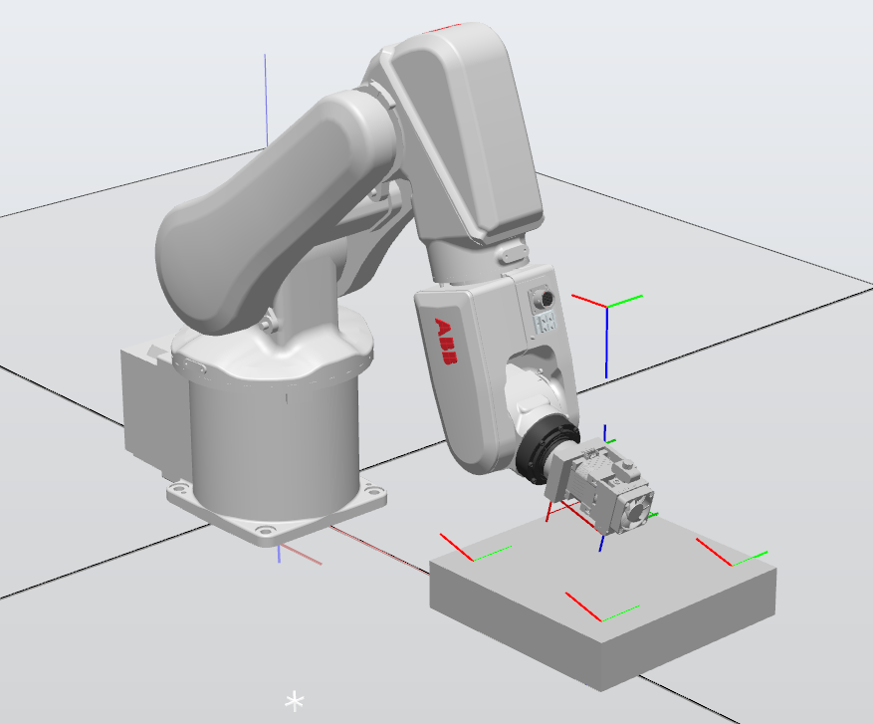
Pathing Controlling Robot Movement
GCode Conversion
Python script used to scape GCode
Looks for movement commands and stores coordinates
Writes up target and movement files
Also Sets I/O for speed control and retraction signals
Simulation
Generated toolpath tested in simulation before running on robot
RobotStudio simulation suite, only 30-day trial
Set up with ABB arm, print bed 150mm in front of robot, raised 100mm
Provided confidence before full scale testing

Slide 7
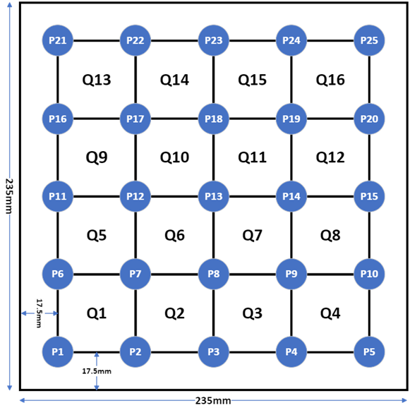
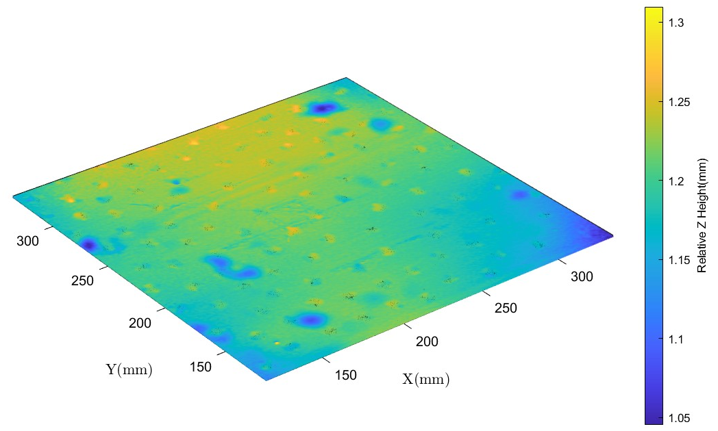
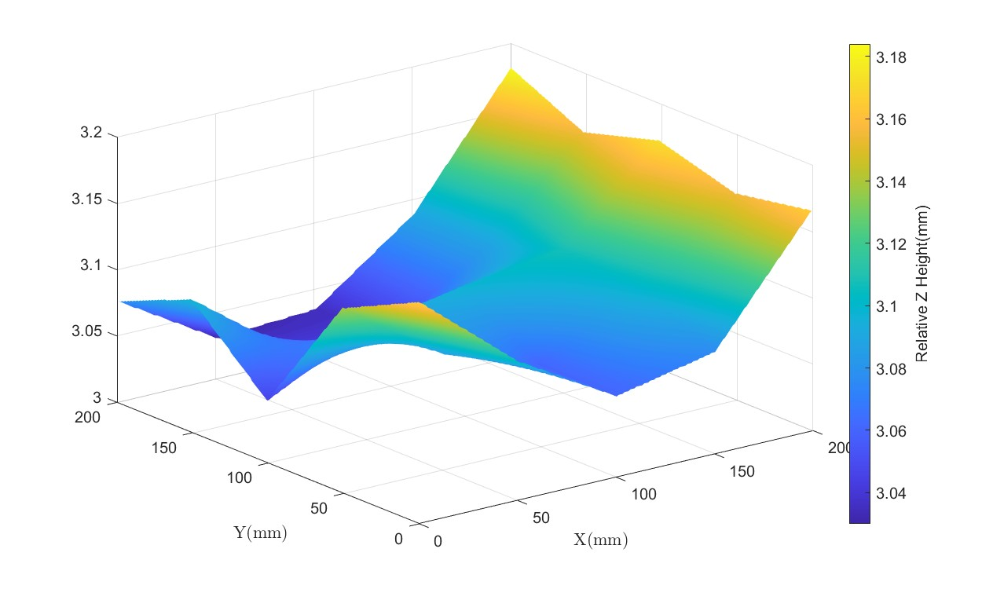
Bed Levelling Probing and Height Adjustment
Probing
Measurements taken at 25 points
Arduino sends signal to register touch
Bed split into 16 quadrants, each assessed individually
3D scan of bed taken for verification of results
Bilinear interpolation
Mesh of bed hight generated using bilinear interpolation
Heights applied to print coordinates
Machine recalibrated due to measurement disagreement
Improved results of line test
Bed height measured locally to an accuracy of ±0.03mm
Bed variance of ±0.6mm accounted for

Slide 8
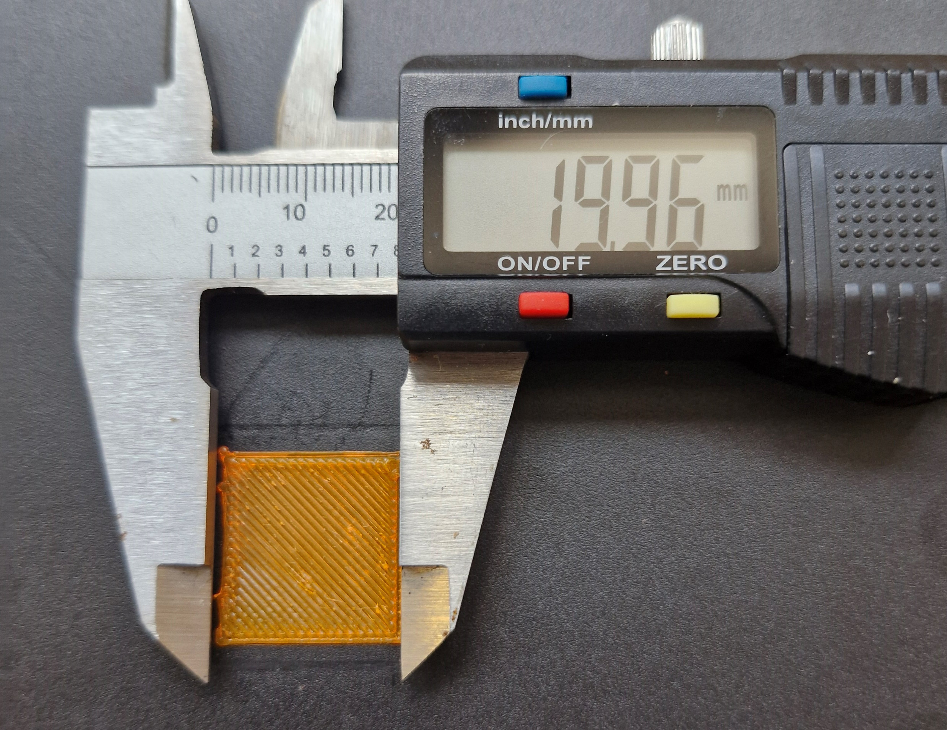
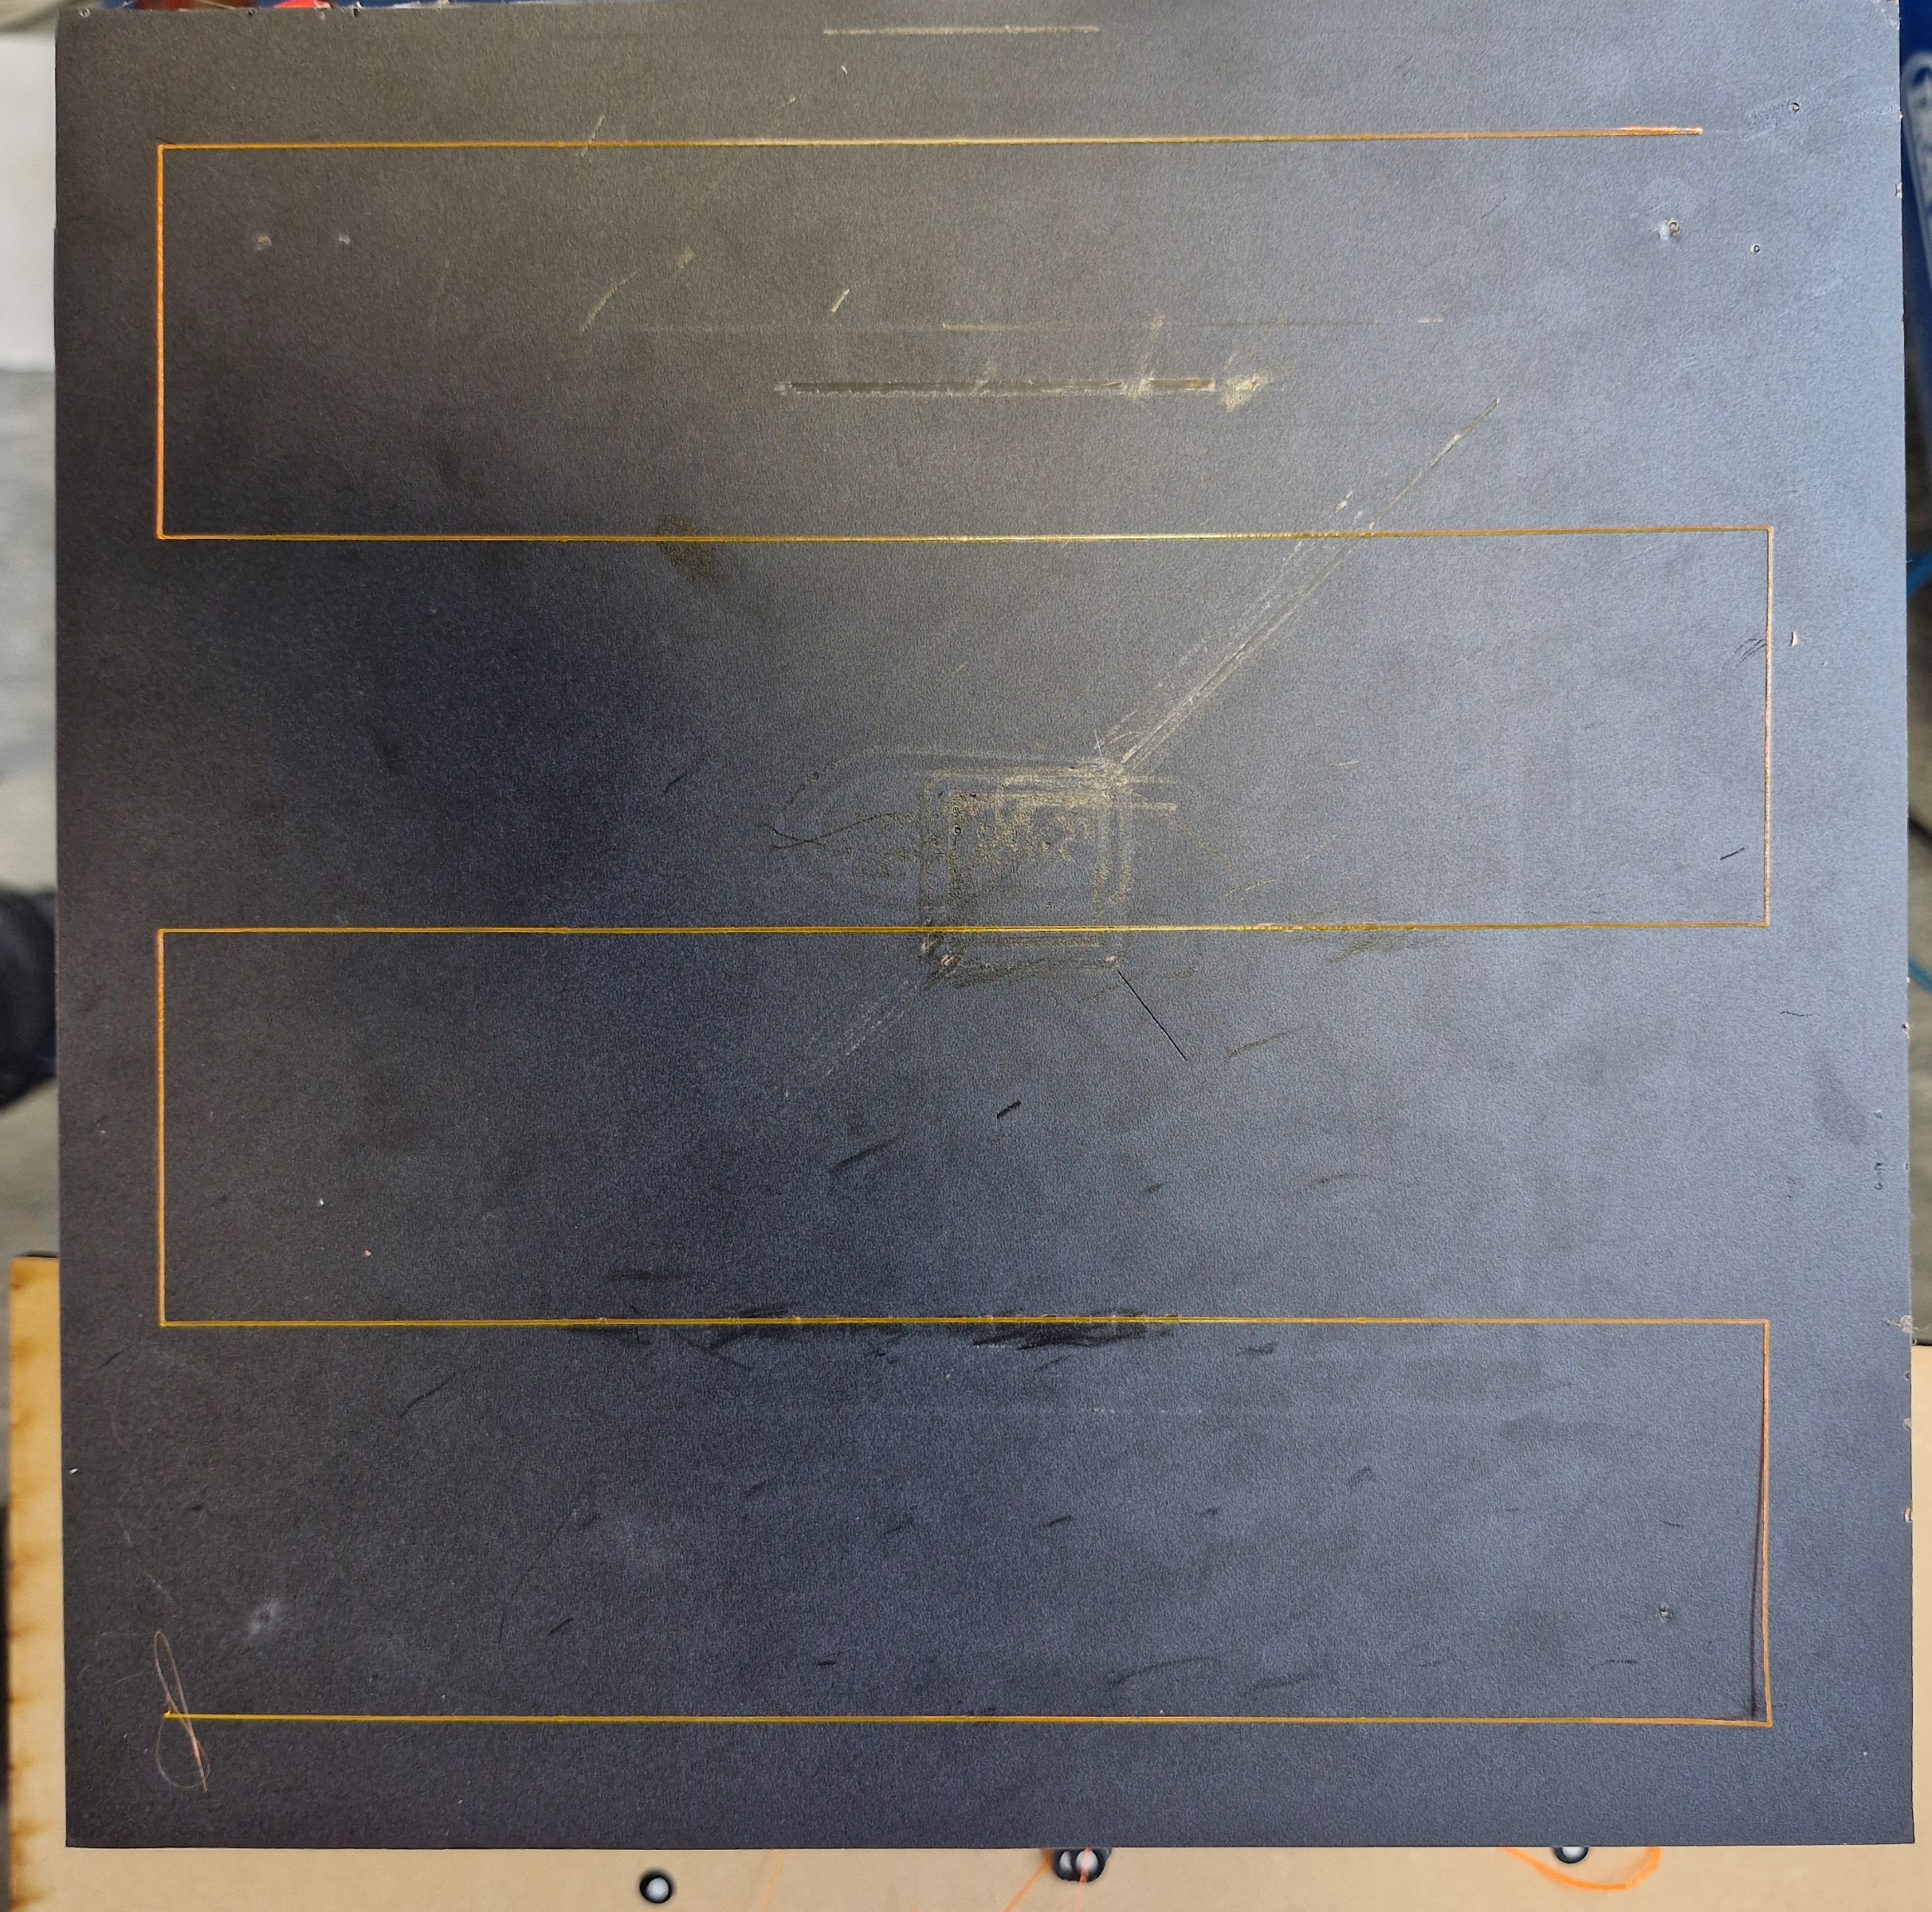
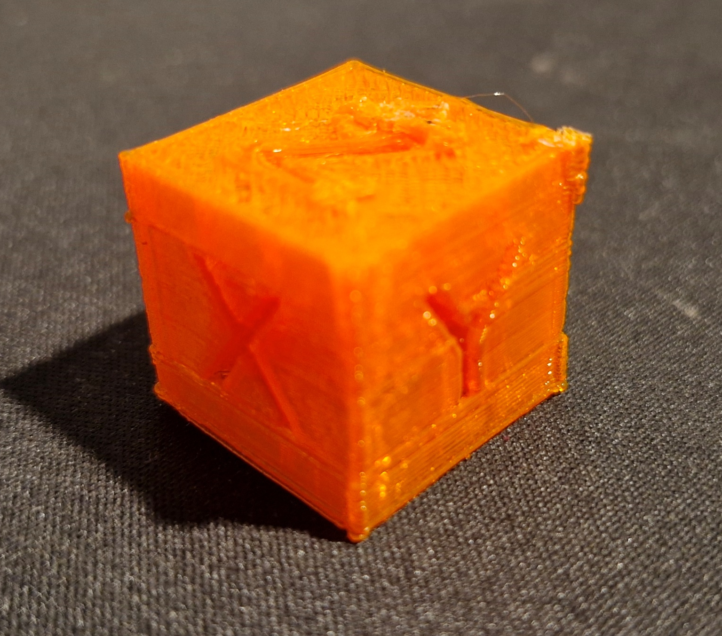
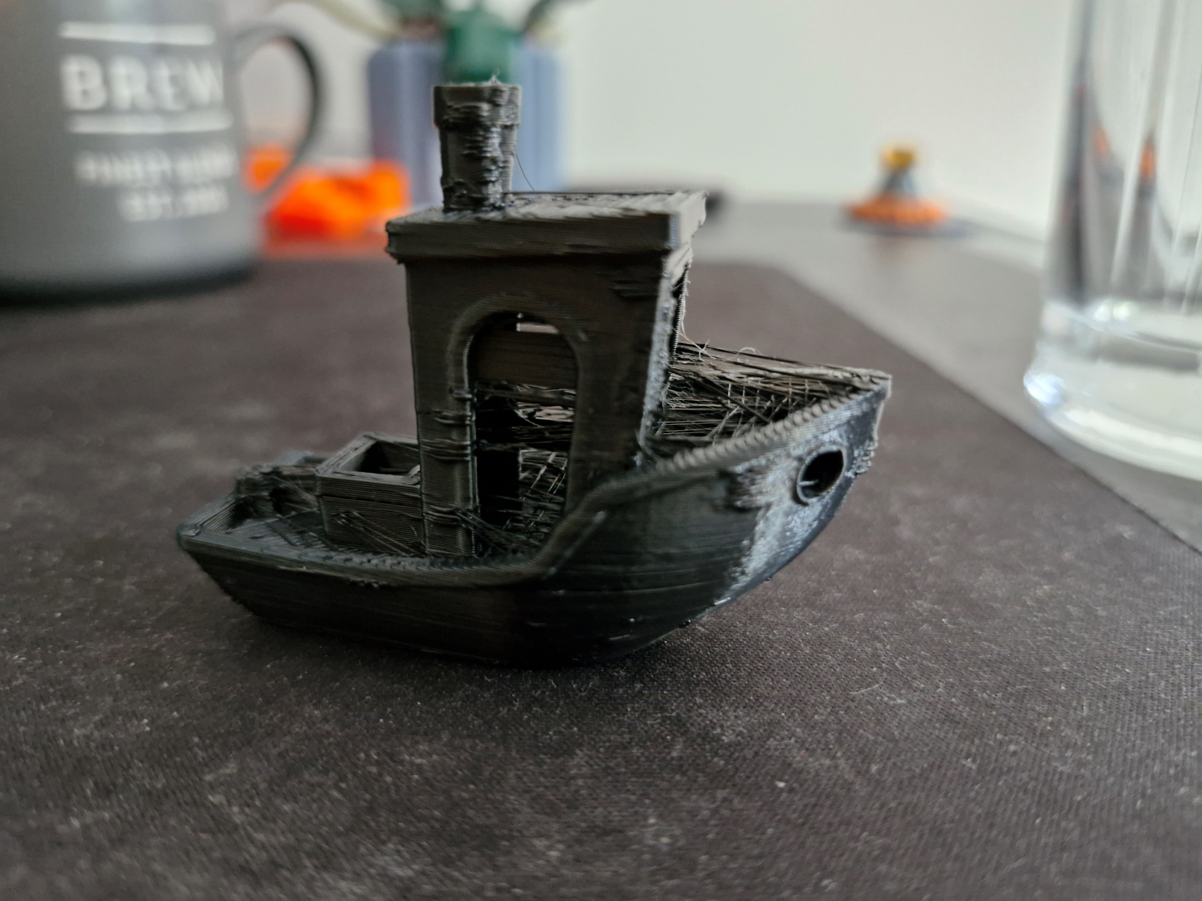
Print Testing Testing the Completed System
Line Test
Zig Zagged line on print bed. Used to assess line width and Z offset. 0.46mm line width achieved.
Square Test
2D square print. Used to assess infill quality, Z offset and dimensional accuracy. ±0.46mm dimensional accuracy achieved.
Calibration Cube
3D cube test. Used to test printing 3D objects, dimensional accuracy, print detail.
Benchy
3D Benchy test. Used to test printing detail, accuracy and viability of file splitting.

Slide 9
The Project Aims and Objectives
Ref | Sub Ref | Aim | Tolerance | Target Met? | Tolerance Achieved
1 | 1.A | All components are mounted to the machine. Cables running to components. Print bed set up in front of machine. | ±1mm |  | Outside of safe zone by 50mm
 | 1.B | System retains full range of motion. | Joints maintain rotation of ±180° |  | Relevant joints rotate 180°+ in both directions
 | 1.C | Bed height and level fully adjustable. | Corner height adjusted ±5mm |  | ±5mm adjustment achieved
2 | 2.A | Extruder can reach and maintaining an acceptable temperature. | ±5°C |  | ±1°C at steady state
 | 2.B | Extruder can extrude a demanded length of filament. | ±0.5mm |  | 0.11mm average variance across all speeds
3 | 3.A | Printer can match print and extrusion speed. | Line width 100% to 120% of the nozzle’s diameter |  | 0.46mm, 115% of nozzle width
 | 3.B | Printer can complete a series of test prints to demonstrate capability. | ±0.5mm |  | ±0.46mm
4 | 4.A | Printer can take a single bed height measurement. | ±0.06mm |  | ±0.03mm
 | 4.B | Several measurements used to autonomously correct for bed level. | ±0.1mm |  | ±0.6mm

Slide 10
Conclusions What has been learned
What was Achieved
Established a fully capable robotic 3D printing system
Able to replicate desktop printer performance
Retrofitted with off the shelf, hobby grade components
Implementation of bed levelling
Setbacks
Print Failures – Failed print tests from poor bed adhesion and jammed nozzles. Rectified by changing filament, and tuning Z offset
Signal Conversions – Arduino and robot controller use different voltage signals. Voltages needed to be converted.
Teamwork - Coordination with other members working on project to ensure effective management of lab time.
Next Steps
Improve positional accuracy – Fully recalibrate and retune the machine. Perform additional testing to find new positional accuracy. Consider using EGM.
Temperature control – Implement PID temperature control on print head and bed. Experiment with different materials.
Improve print quality – Perform further tuning of parameter to improve overall print quality
Multi axis demonstration – Testing of non-planar printing and utilisation of multi axis capabilities

Slide 11
Thank you for Listening
Questions?

